Slide 1
Analyzing the scheduling and performance of neural nets that use pipeline parallelism
Aditya Shankar, 170905094, CSE B, Roll No. 17

Slide 2
Background
Scaling neural nets requires optimization from systems level.
Large model sizes can severely limit training time
Data parallel and model parallel approaches are common
Pipeline parallel approaches have become popular recently
GPipe is a library developed by Google for implementing this.

Slide 3
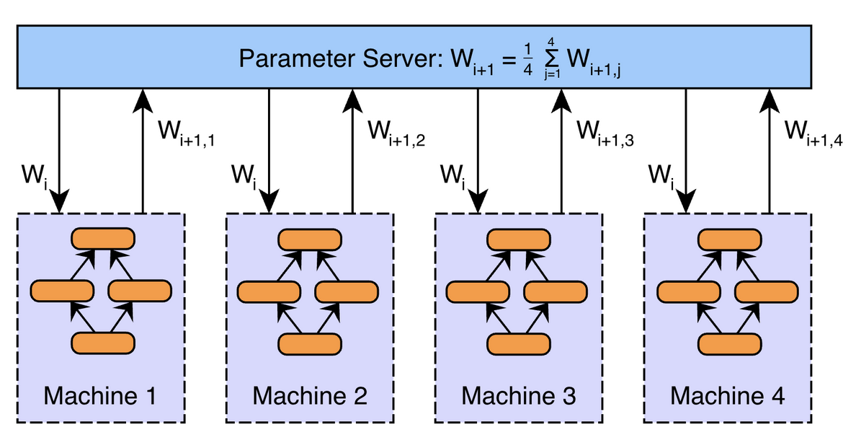
Background
Data parallelism: Model params replicated across devices

Slide 4
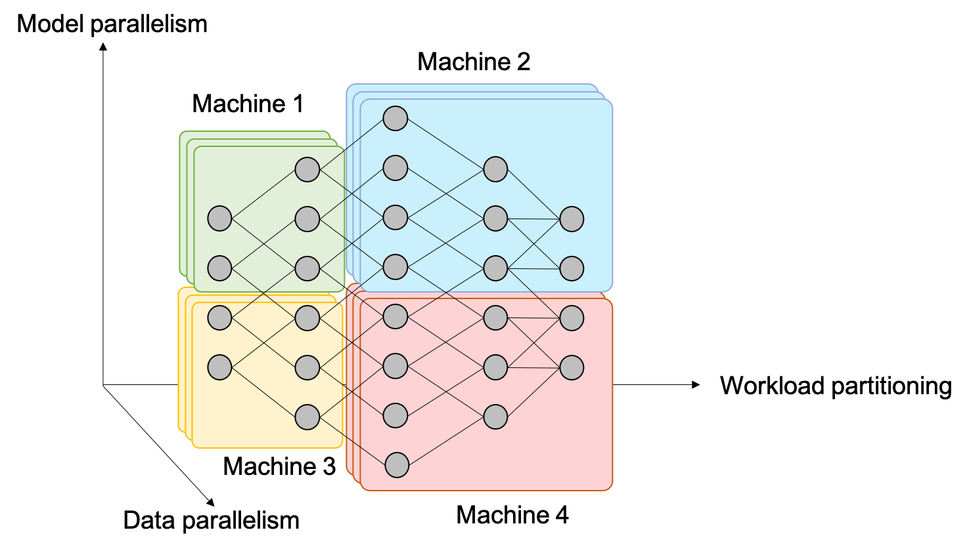
Background
Model parallelism: Model parameters are partitioned across devices

Slide 5
Drawbacks of existing methods
Data parallelism
High cost of aggregating gradients due to communication costs
Improving speed of GPU computation shifts bottleneck towards communication further.
Model parallelism
How to partition to maximize efficiency?
Under utilization because only subset of devices are computing at any time.

Slide 6
A newer approach – Pipeline parallelism
The layers of model are partitioned across devices
For example, a 32 layer model may be partitioned with layers 1-8 on GPU:0, 9-16 on GPU:1, 17-27 on GPU:2 and 28-32 on GPU:3
Minibatches or micro batches can be pipelined across this partitioned network.
Micro batches are further divisions of a minibatch

Slide 7
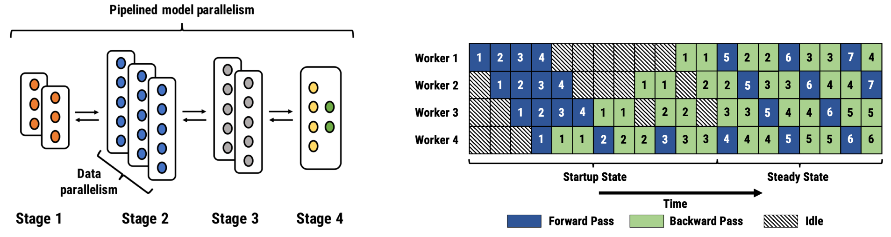
Pipeline parallelism
Diff. minibatches/micro batches

Slide 8
Advantages of pipeline parallelism
Communication restricted to tensors/activations at the partition boundaries
Pipelining improves utilization as multiple devices are active

Slide 9
GPipe – A library implementing pipeline parallelism
Divides a minibatch into micro-batches and pipelines them across devices
GPipe uses re-computation to save memory (activations stored at partition boundaries only)
Part of Lingvo framework (newly developed by Google for NLP)
Lingvo works on top of tensorflow
GPipe supports both auto-partitioning and manual partitioning of layers

Slide 10
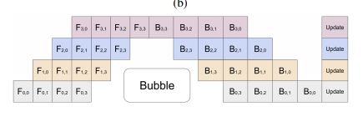
Pipeline parallelism in GPipe
FProp
BProp
Diff. pipelining stages
Micro-batches

Slide 11
Project tasks
Preliminary testing to understand framework intricacies/functioning
Statistical techniques for measuring performance
Primary testing
Identifying bottlenecks

Slide 12
Illustration of partitioning
conv1
pool1
conv2
Set of layers created (LeNet model)
pool2
fc1
sm1

Slide 13
Assume we choose to partition with split sizes of 2 layers each
Split 1
conv1
conv2
fc1
pool2
Split 2
sm1
pool1
Feature Extraction
Split 3

Slide 14
Extending the compatibility of Lingvo with GPipe
Lingvo is primarily focused on NLP training
So at present supports GPipe for limited layers (like Transformer layer, encoder layer)
Inclusion for other layers requires implementation of FPropMeta()
This function is used to estimate meta-flops of each layer. Used for auto-partitioning

Slide 15
Model specifics
LeNet5 model with approx. 763000 parameters
Input minibatch of dimensions of (256,28,28,1)
MNIST dataset for digit classification
16 micro-batches of size (16,28,28,1)
2 GPU system on AWS – M60 Tesla GPUS with 8GB each
model divided into 2 splits:
Split 1: conv1, pool1,conv2
Split 2: pool2, fc1, sm1

Slide 16
Primary testing and performance analysis
Done using a profiling tool, TensorFlow Profiler
This tool provides information on expensive kernel calls and TensorFlow operations.
Provides trace files, pie-charts, and tables to easily analyze data
Profiling data can be viewed using TensorBoard

Slide 17
Expected behavior
Send output activations
split1
split2
Receives activations and performs FProp
Send outputs
This happens multiple times depending on no. of micro-batches
Forward prop
backprop
recomputation
backprop
This also happens multiple times depending on no. of micro-batches

Slide 18
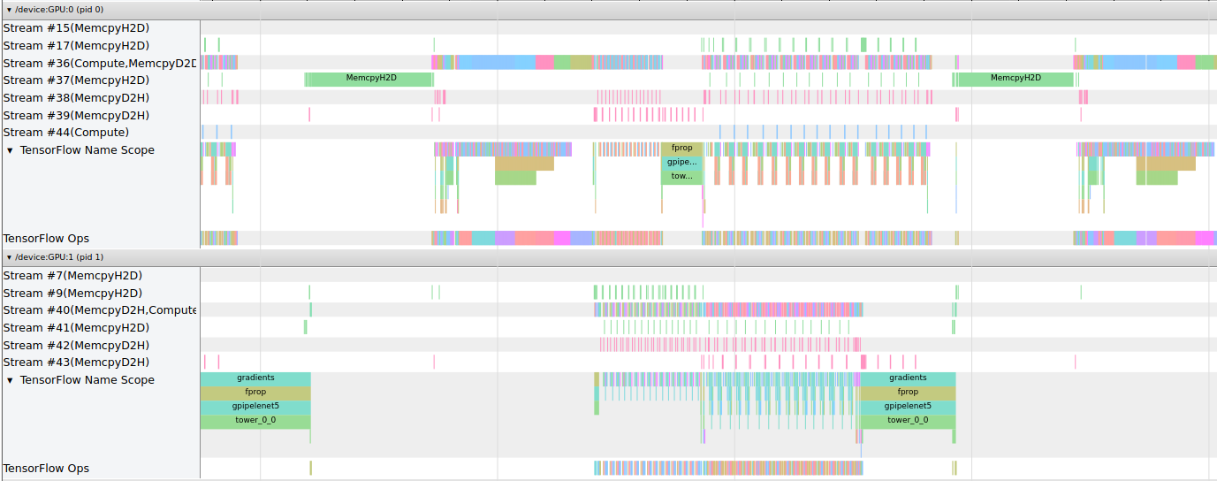
High level view of operations
Loading graph vars
Pre-processing
fprop
bprop
Device
Notes:
18

Slide 19
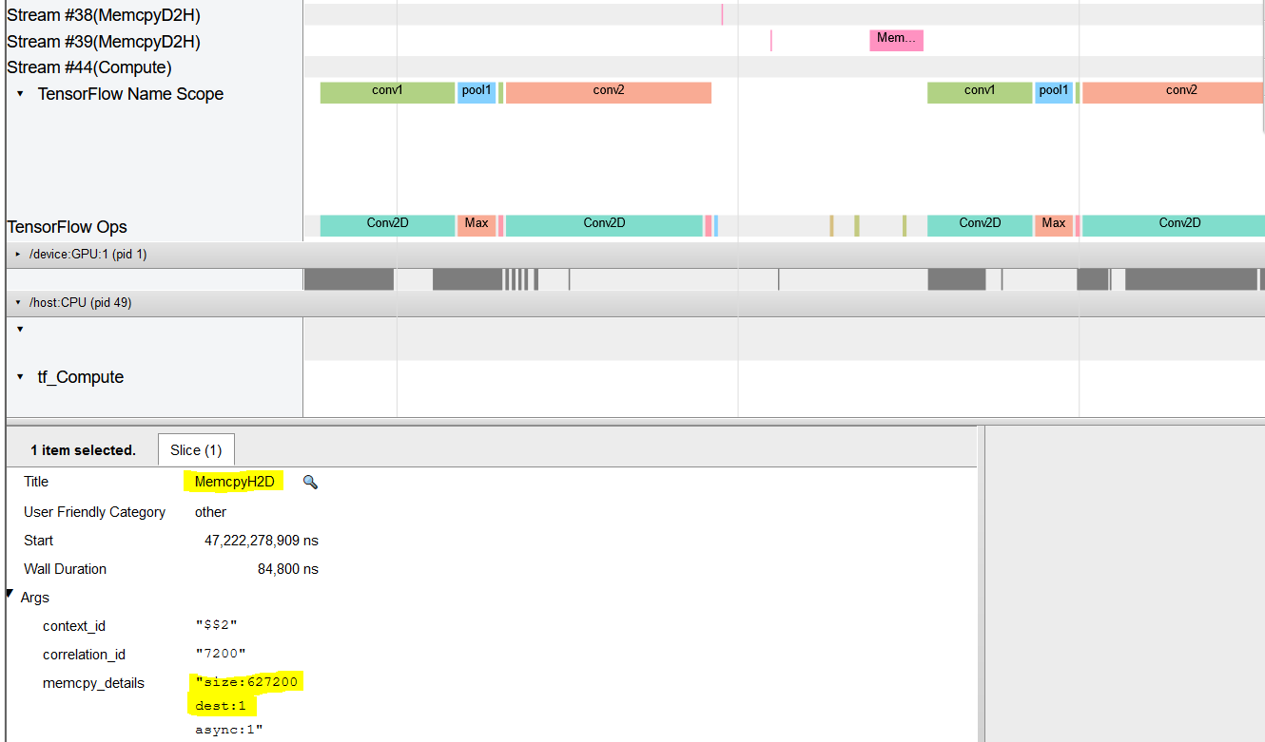
FProp
First partition’s ops only performed
Computations on GPU: 0
Data transfer to GPU:1
Notes:
19

Slide 20
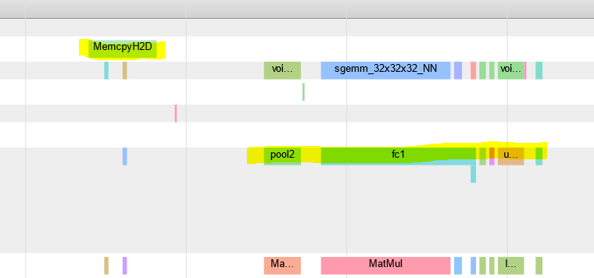
Operations on gpu 1
Corresponding recv

Slide 21
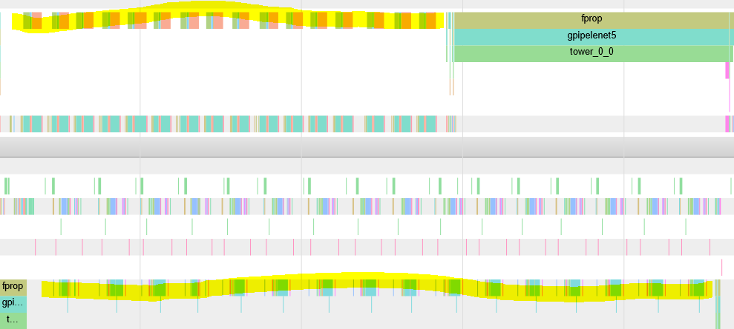
Last FProp. Done on 16th micro-batch.
The skew may be due to asynchronous sends

Slide 22
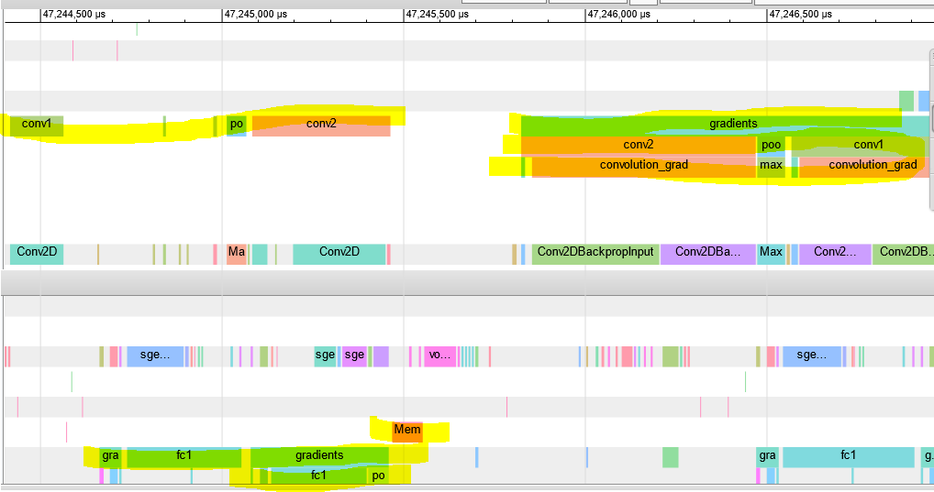
BProp
recomputation
Backprop computation done on first split after recv called (not shown in pic)
Recomp.
D2D comm.
BProp on gpu1

Slide 23
Comparison of major operations

Slide 24
Division of FProp ops in GPipe
9.63 ms

Slide 25
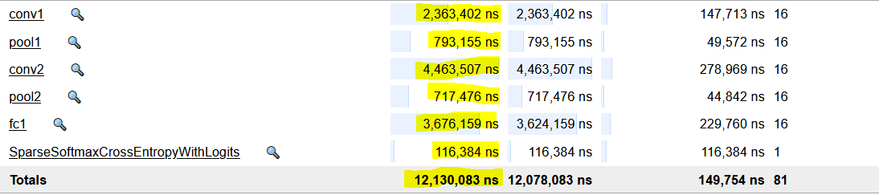
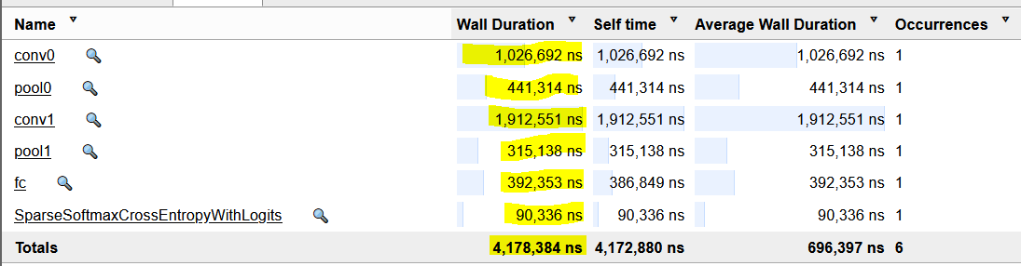
Comparison of FProp computation times
GPipe
Non-GPipe
GPipe total compute time across microbatches is greater than batch processing scenario. Why?

Slide 26
Division of BProp operations in GPipe

Slide 27
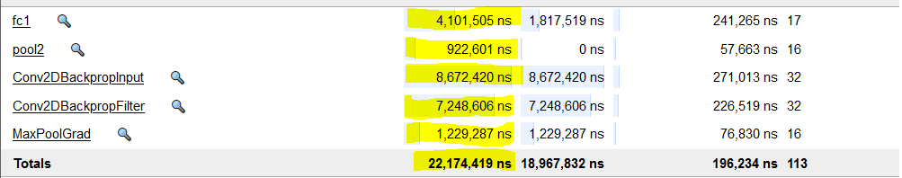
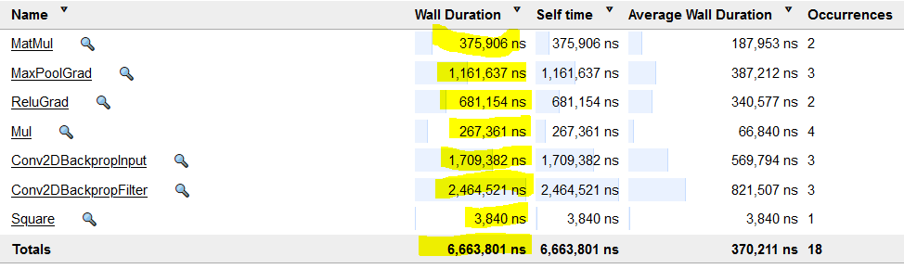
Backprop times
gpipe
No gpipe
Again, accumulated computation time increases with micro-batch partitioning rather than batch processing.

Slide 28
Remarks
Cumulative time spent in comm. does not differ by much between FProp and BProp
This is expected because data sent at boundaries is similar irrespective of FProp/BProp

Slide 29
Remarks
The primary bottlenecks seem to be:
The increase in computation times due to splitting rather than batch processing
Communication times between partition boundaries
Re-computation. Might have increasing impact with more layers

Slide 30
Pending tasks
Testing with more GPUS
Verification of data-parallelism for GPipe (because of lib modification)
Analyzing the minibatch size and number of micro-batches for optimal performance
Analysis of data parallelism

Slide 31
References
[1] Aaron Harlap, Deepak Narayanan, Amar Phanishayee, Vivek Seshadri, Nikhil Devanur, Greg Ganger, Phil Gibbons. PipeDream: Fast and Efficient Pipeline Parallel DNN Training. June 2018
[2] Y. Huang et al. GPipe: Efficient Training of Giant Neural Networks using Pipeline Parallelism, 2019
[3] Jonathan Shen et al. Lingvo: A Modular and Scalable Framework for Sequence-toSequence Modelling. Feb 2019
[4] https://github.com/tensorflow/lingvo
[5] Chen et al. Efficient and Robust Parallel DNN Training Through Model Parallelism On Multi-GPU Platform, Oct 2019
[6] Guan et al. XPipe: Efficient Pipeline Model Parallelism for Multi-GPU DNN Training. Nov 2020
[7] https://www.microsoft.com/en-us/research/project/fiddle/
[8] Arpan Jain et.al. Performance Characterization of DNN Training using TensorFlow and PyTorch on Modern Clusters. Sept 2019
[9] Jie Liu et.al. Performance Analysis and Characterization of Training Deep Learning Models on Mobile Devices. Sept 2019
[10] Shi Dong et.al. Characterizing the Microarchitectural Implications of a Convolutional Neural Network (CNN) Execution on GPUs. April 2018
[11] Robert Adolf et.al. Fathom: Reference Workloads for Modern Deep Learning Methods. Oct 2016
[12] https://www.tensorflow.org/guide/profiler20
[13] https://en.wikipedia.org/wiki/LeNet

